Slide 1

WELCOME
To our CSE Family

Slide 4

Let's get introduce…

Slide 5
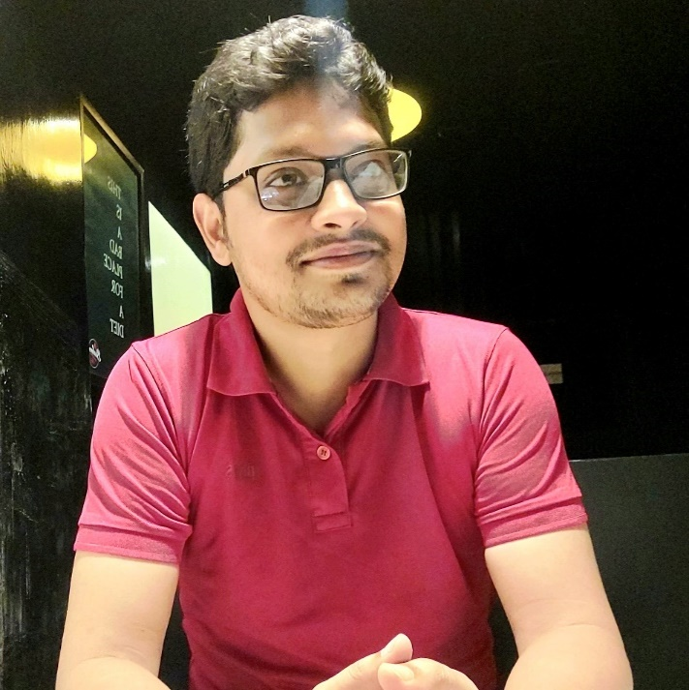
Introduction
Name : Assaduzzaman Ryadh
Address : Rangpur

Slide 6
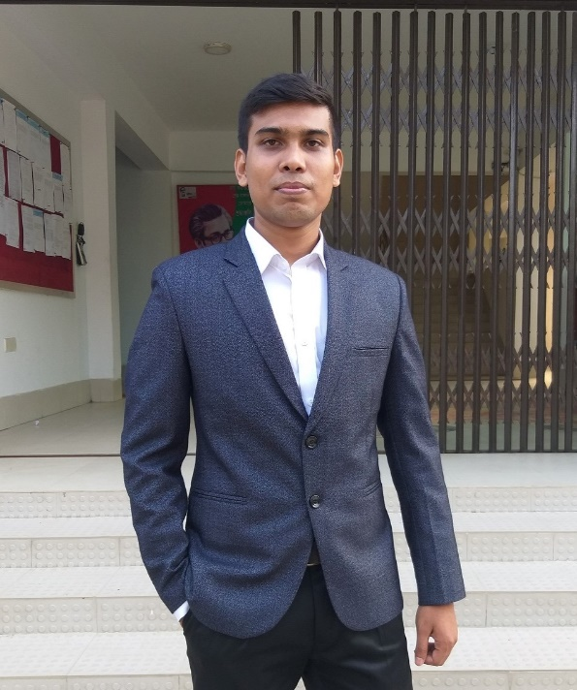
Introduction
Name : Mahfujar Rahman
Address : Pirgaccha, Rangpur

Slide 7
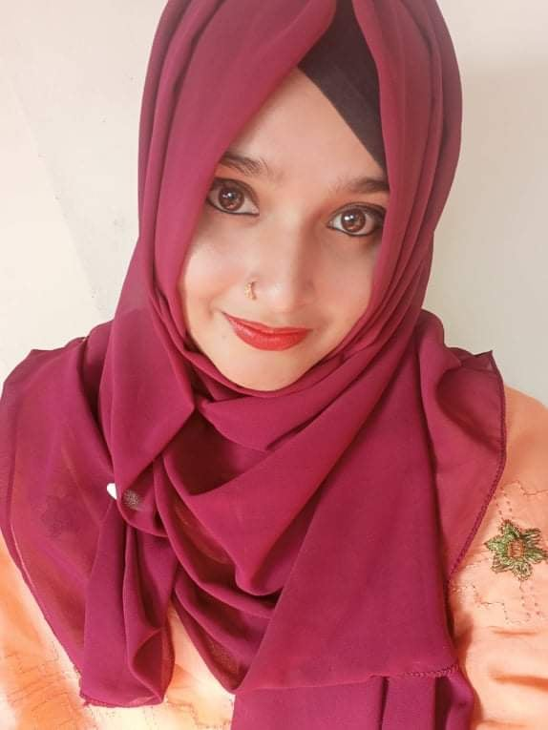
Introduction
Name : Ramisha Nushrat
Address : Pirgaccha, Rangpur

Slide 8
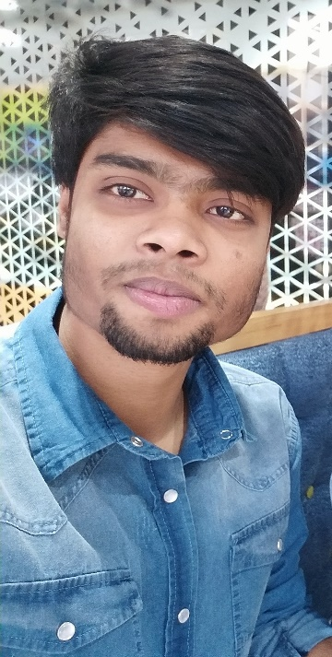
Introduction
Name : Nasir Bin Mahabub
Address : Rangpur

Slide 9
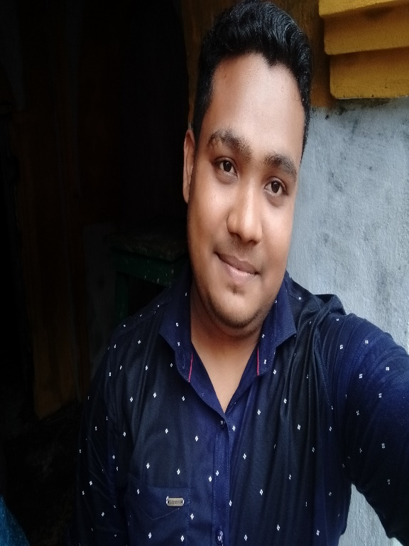
Introduction
Name : Shitol Sarker
Address : Vinnaya Jagot, Rangpur

Slide 10
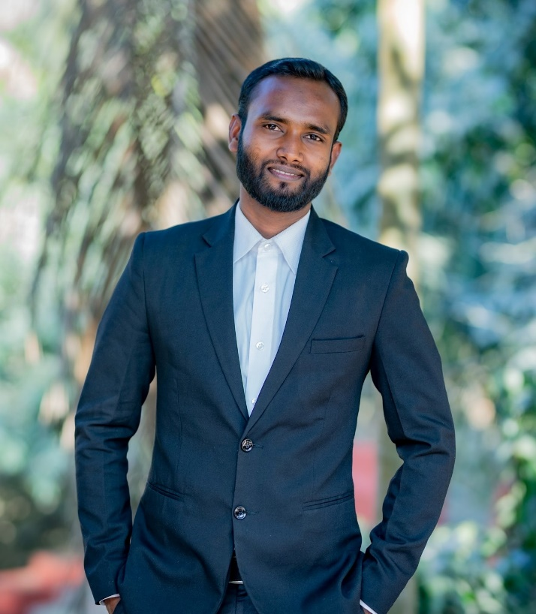
Introduction
Name : Anwar Shakil Riad
Address : Alamnogor, Rangpur

Slide 11
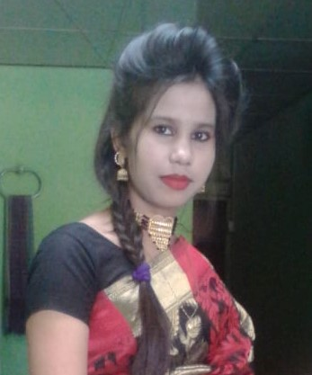
Introduction
Name : Khadeza Akther Mitu
Address : Mithapukur, Rangpur

Slide 12
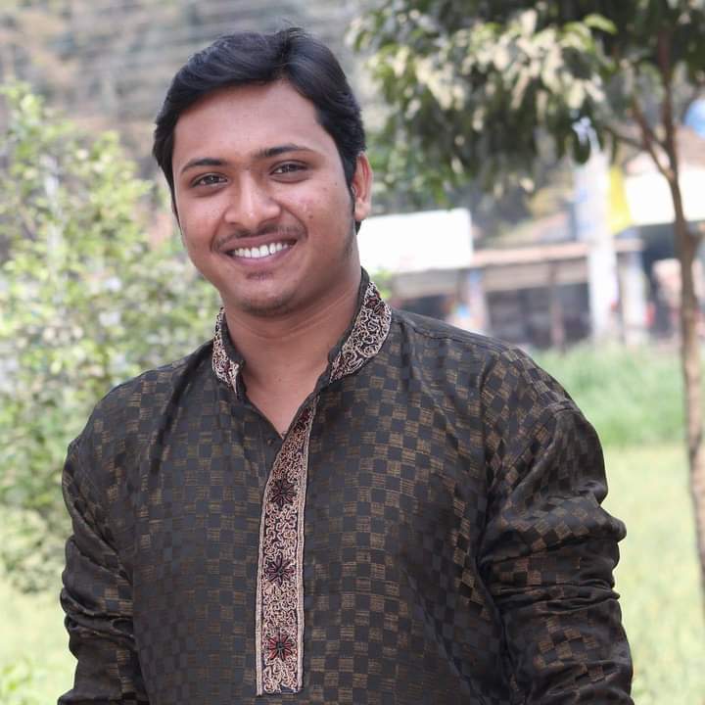
Introduction
Name : Mostasim Billah
Address : Lalmonirhat

Slide 13
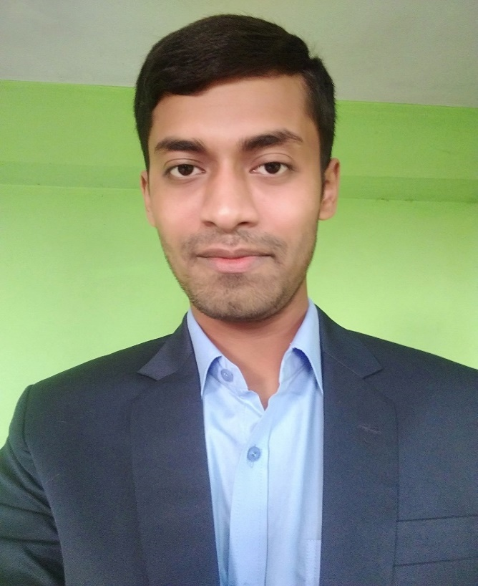
Introduction
Name : Asif Hasan
Address : Thakurgaon

Slide 14
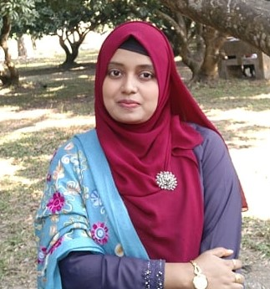
Introduction
Name : Sohele Emrose Eva
Address : Thakurgaon

Slide 15
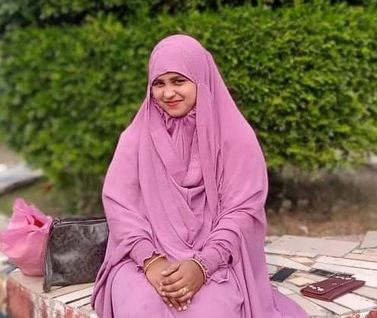
Introduction
Name : Farjana Hossain
Address : Kushtia

